Slide 1
Fraud Detection Using Biometrics
Anqi Wang
Debasish Kaushik

Slide 2
Current Challenge
Fraudsters are getting more sophisticated and smart
More than 50% of successful damaging attacks are initiated by valid user credential
Need a better and faster way to detect fraud

Slide 3
What is biometrics?
Definition: Science of identifying individuals based on their physical or behavioral characteristics
Behavioral biometrics: The field of study related to measure of uniquely identifying patterns in human activities.
Types
Finger prints
Eyes retina scan
Face recognition
Voice recognition
Keystrokes dynamics
Mouse movement

Slide 4
Why use behavioral biometrics?
Hard to be replicated by fraudsters
Gives better accuracy rate
Can be easily productized (companies like IBM and Splunk already have similar product in the market)

Slide 5
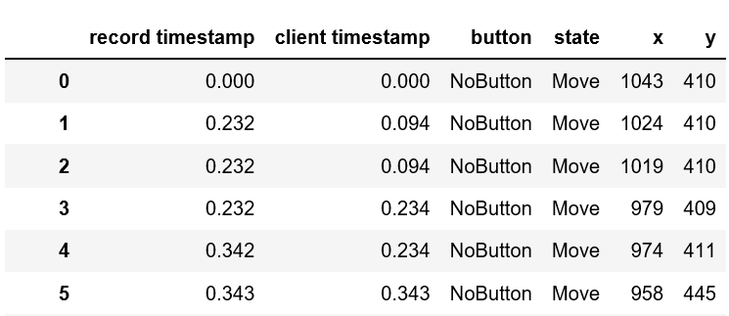
Current State of the Industry
Complicated action of feature extraction
Heavy preprocessing
Computationally expensive
Complexity of the task is not fully captured
Low accuracy rate

Slide 6
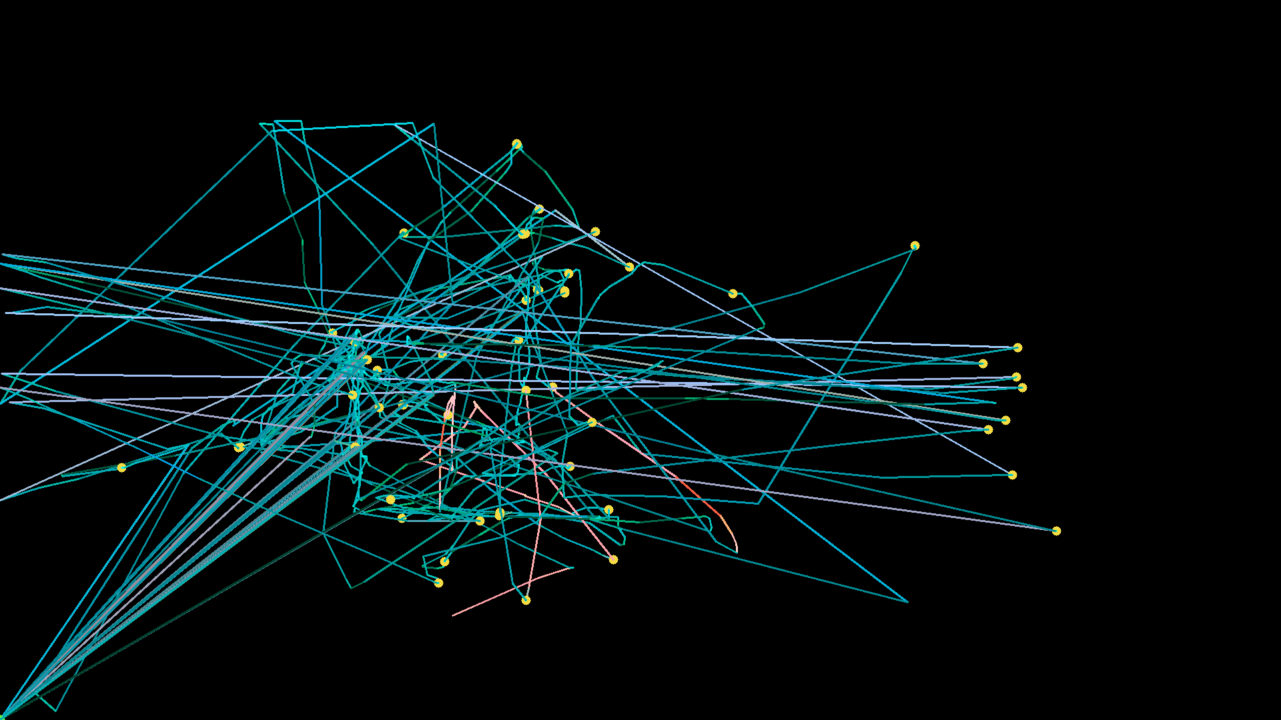
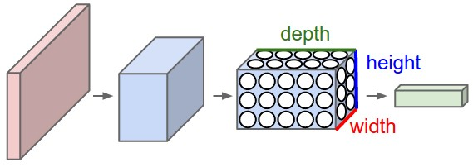
How to solve this problem?
Convert session to an image
Take image and feed it to a CNN(convolutional Neural Network)

Slide 7
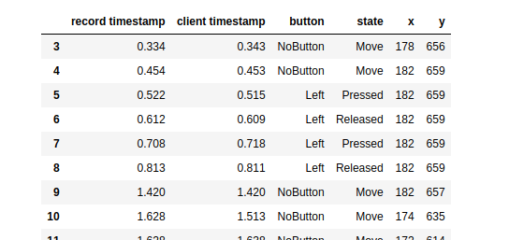
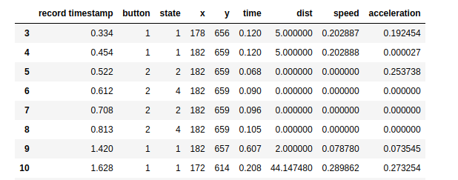
Color Encoding
Notes:
This is the most tedious process
Explain the given dataset
Explain the feature extraction/normalization
How dots are created and about drag – becomes red

Slide 8
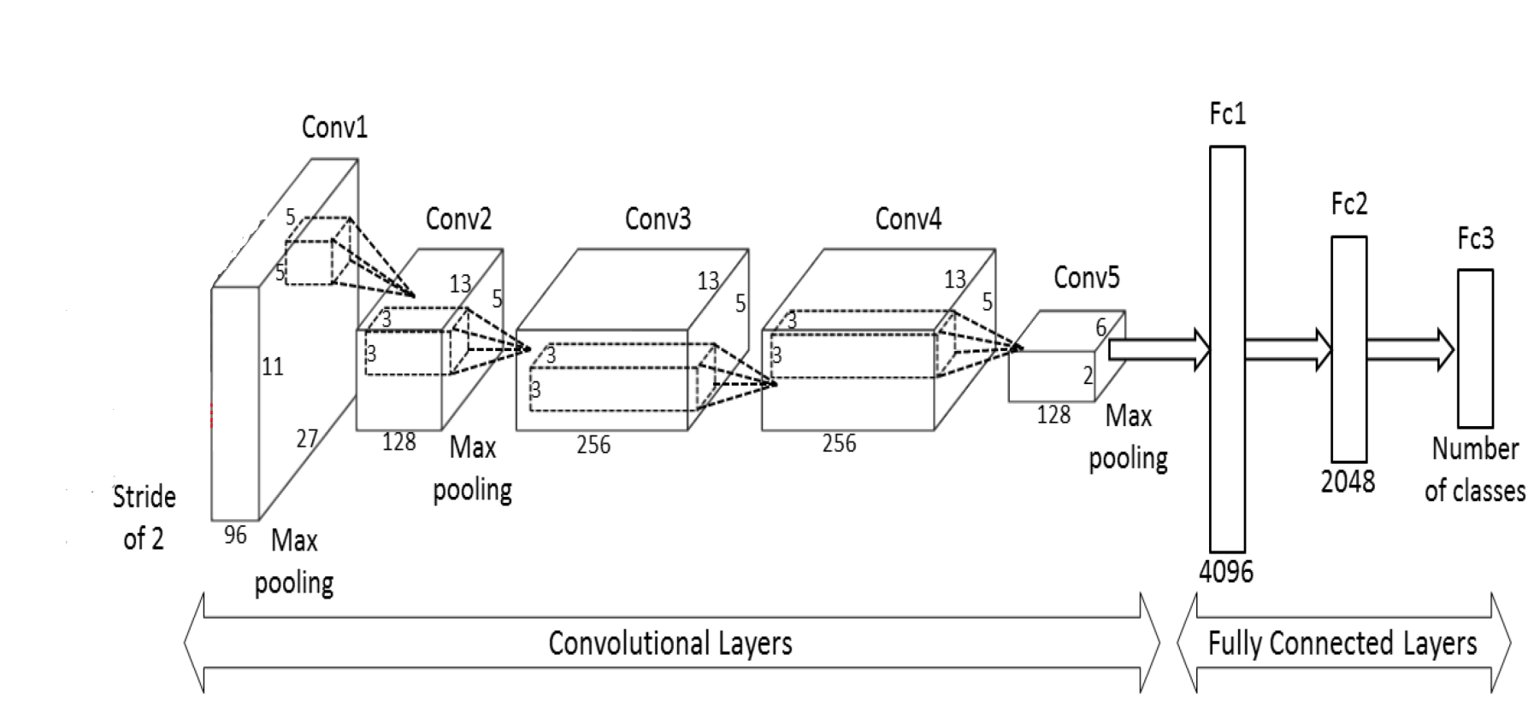

Train image with CNN
Feed this image into a CNN
Architecture used – ResNext50

Slide 9

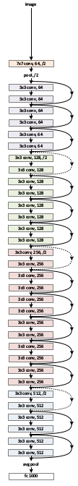
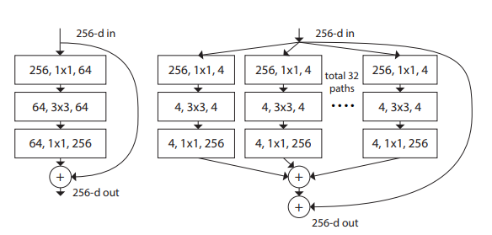
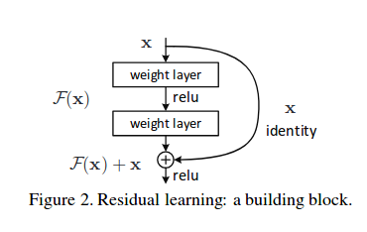
Resnext50 Architecture - in brief
Plain network
Resnet Architecture
Resnet vs resnext block
Residual block
Notes:
Vanishing and exploding gradient are real problems in nn
The solution is skip connection, that you take input from one layer and then feed it into an much deeper layer in the nn
Resnets are consists of residual blocks
This blocks can be deeper too. Resnet50 is 3 layers deep

Slide 10
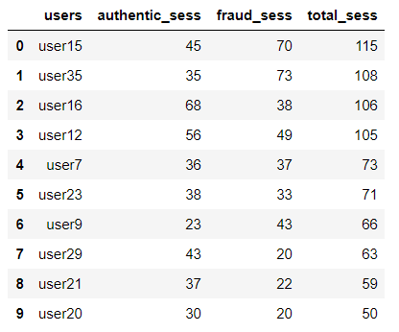
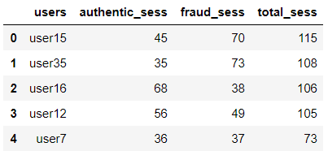
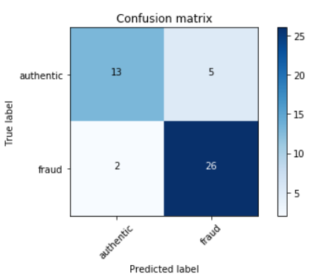
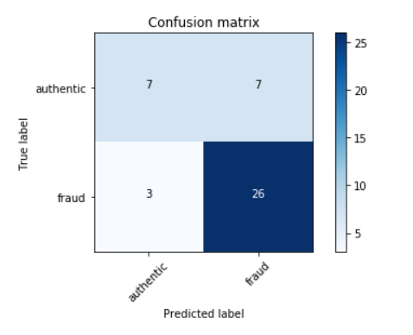
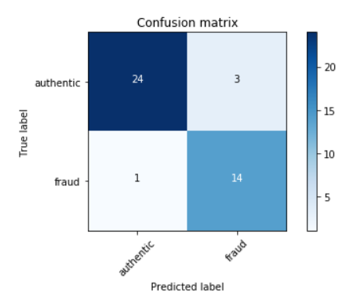
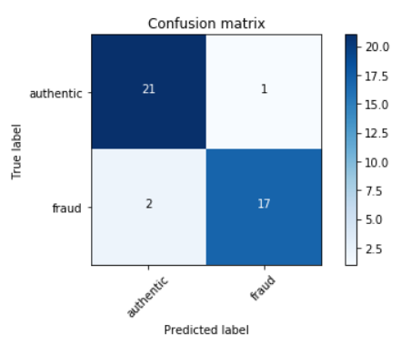
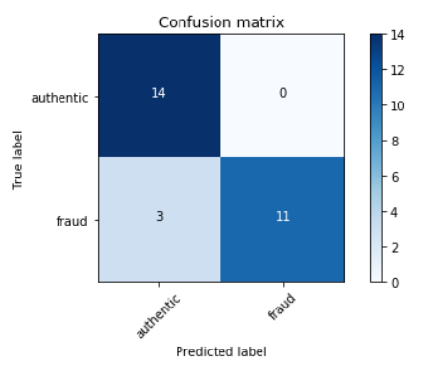
Results
We had 10 users in our dataset
User 15
Test set accuracy: 84.7%
User 35
Test set accuracy: 76.7%
User 16
Test set accuracy: 90.4%
User 12
Test set accuracy: 92.7%
User 7
Test set accuracy: 89.3%

Slide 11
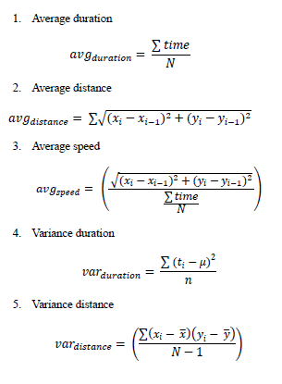
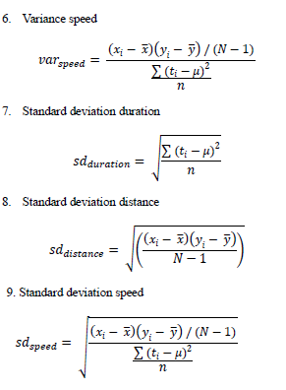
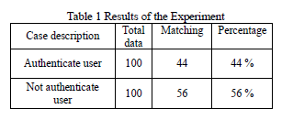
Results/Accuracy with structured data
Found a paper(2015) produced on the same dataset (link in notes)
They concluded mouse movement
biometrics tracking is itself not sufficient,
and must be combined
with other form of data
Notes:
1) https://www.researchgate.net/profile/Roslinda_Muda/publication/319202215_Mouse_Movement_Behavioral_Biometric_for_Static_User_Authentication/links/59dc23de0f7e9b1460fc354b/Mouse-Movement-Behavioral-Biometric-for-Static-User-Authentication.pdf?origin=publication_detail
2) They mostly went for aggregating the session to find features

Slide 12
How to improve the accuracy
More data – currently we had roughly around 100 images per user.
More time – experiment with image encoding is very important, as some encoding might give better results, plus more model tuning.

Slide 13
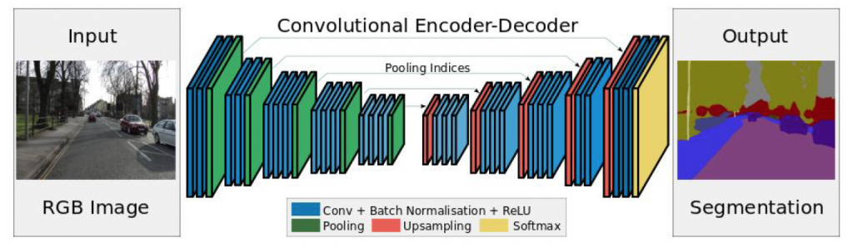
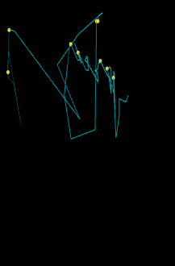
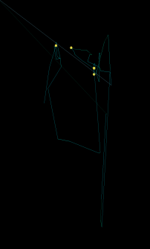
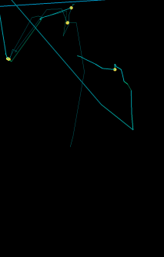
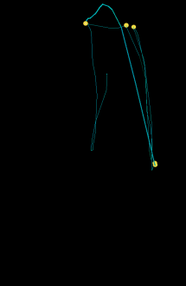
How to improve the accuracy
Research is undergoing a transition from “feature engineering” to “network engineering”
Auto encoder
RNN(Recurrent Neural Network)
t
t+1
t+2
t+3
Y
LSTM
LSTM
LSTM
LSTM
CNN
CNN
CNN
CNN

Slide 14
Revenue Impact
The global biometric market is expected to grow from USD 10.60 billion in 2016 and estimated to reach USD 41.39 billion by 2025, at 17.06% CAGR(compound annual growth rate ) during 2017-2025.
Strong market demand for security protocol driven by biometrics
Experian has joined forces with technology firm BioCatch
Behaviosec
Iovation
Kaspersky
Lexis nexis voice biometrics
Easy to implement
Not hard, thanks to papers and stable open source implementation of them.
Other use cases
Marketing
Notes:
We found some studies claiming that more than 770 million biometric authentication applications will be downloaded each year by 2019.
http://fortune.com/2017/04/07/experian-biometrics-startup-fraud-online/
https://www.bayometric.com/global-biometric-market-analysis/
https://www.gartner.com/doc/reprints?id=1-4VK4I5D&ct=180409&st=sb
Other use cases:
Cannot only be applied in cybersecurity but also can be applied in many other business sector. For example it can be used for marketing purpose to help companies better understand and identify their target audience
Summarize:
If we can successfully implement and adopt this solution, we will significantly reduce company fraud risk and boost consumer confidence and help generate more revenue by better identifying out potential customers

Slide 15
QUESTIONS

